Slide 1
Nilavembu Herbs Case Study
By Karthick

Slide 2
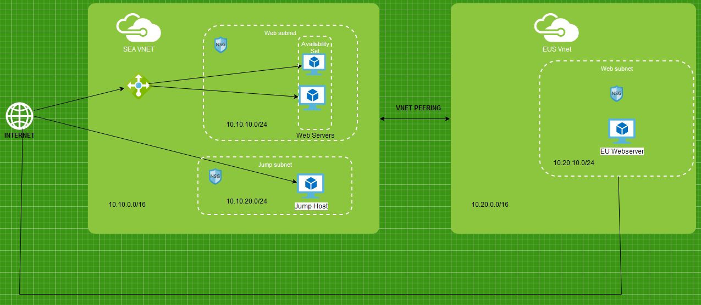
Network Architecture

Slide 3
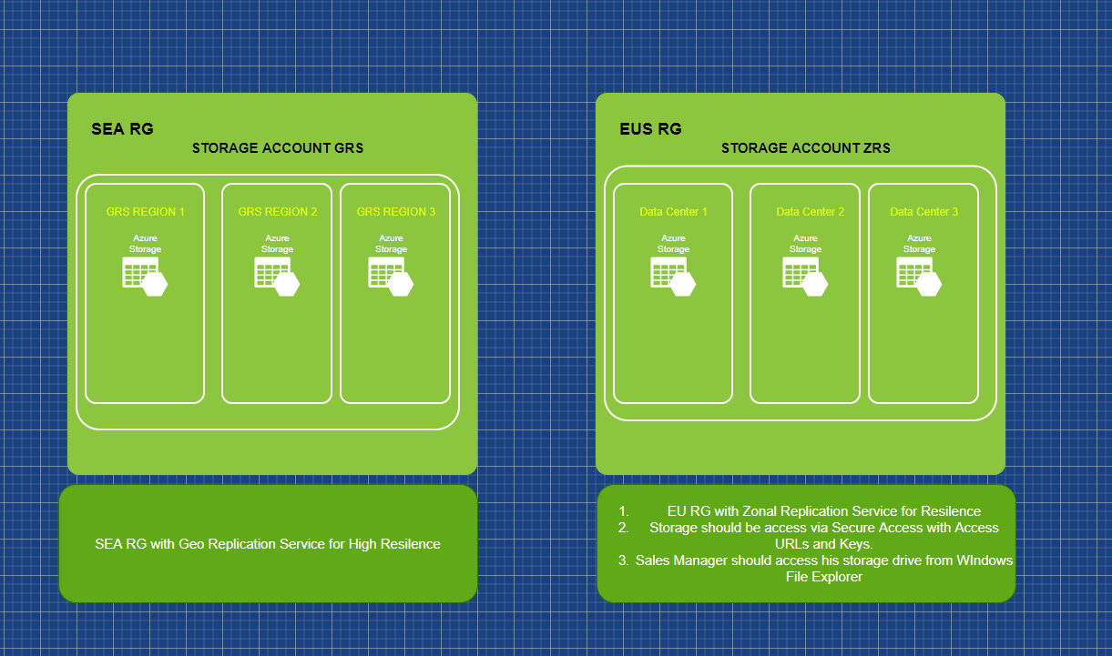
Storage Account

